Slide 1
Health Information and Low Numeracy: Challenges and Solutions
By: Sean Duan

Slide 2
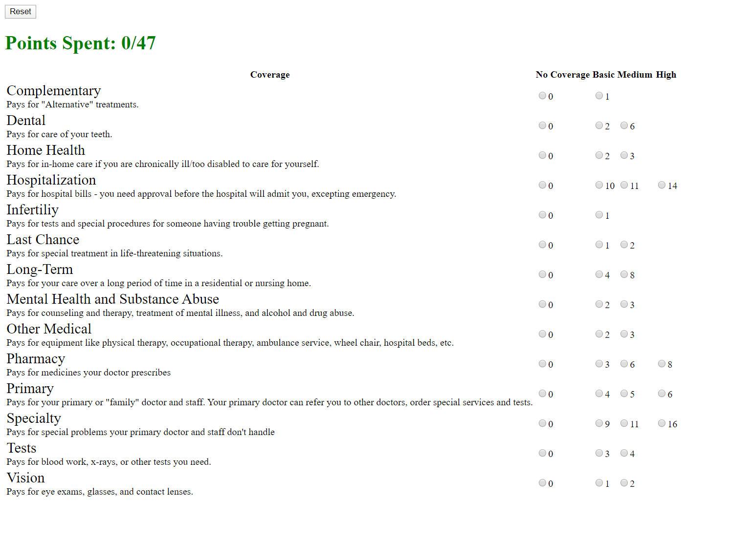
A Brief Recap: Our Study
Our original study was to see if giving people a ‘hands-on’ exercise would improve support for Universal Health Care
Compared against ‘normal’ informational pamphlets
Exercise was a ‘simulation’ of budgeting limited healthcare resources

Slide 3

A Brief Recap: Our Study
Our initial mediational hypothesis:
Hands on exercise would lead to increased comprehensibility/ understanding of the mechanics behind UHC
Hands on exercise would improve perceptions of equity and fairness of healthcare distribution through UHC
Greater comprehensibility and greater perception of fairness was hypothesized to lead to more support for UHC.

Slide 4
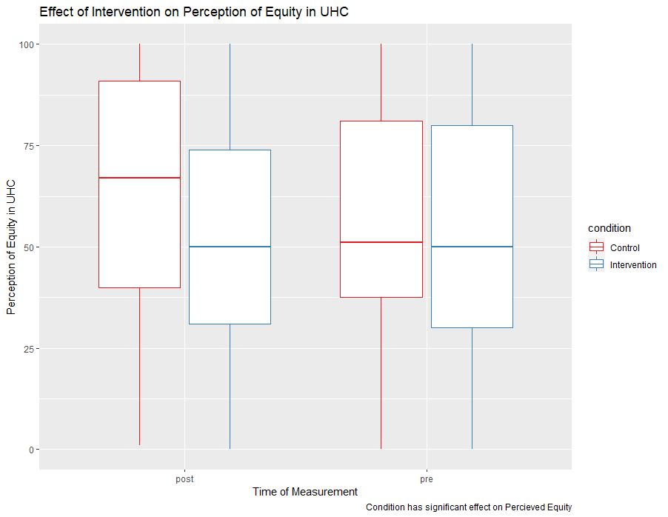
A Brief Recap: Our Results
Intervention did not ↑ Support UHC
Mediational Relationship exists!
Intervention did not ↑ Perceived Equality
Perceived Equality ↑ Support UHC
Control did ↑ Perceived Equality
No difference in ↑ Understanding b/w conditions
Understanding ↑ Support UHC

Slide 5
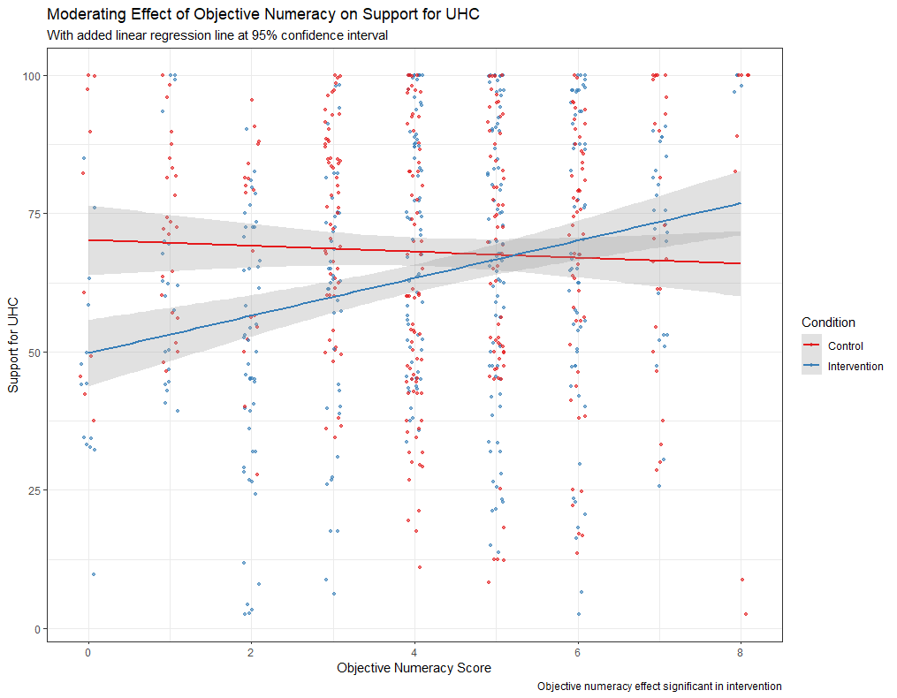
A Brief Recap: Our Results
Moderating Relationship Exists!
Subjective Numeracy does not ↑ Support UHC
Objective Numeracy ↑ Support UHC
Intervention only!

Slide 6
The intervention works great for people who are good at math… are people good at math?

Slide 7
People are not good at math
As many as HALF of adults incorrectly believe one million sits at the midpoint between 0 and 1 billion¹
22% of adult Americans have ‘below basic’ proficiency in math²
Ability to do simple addition and subtraction problems
33% of adult Americans have ‘basic’ proficiency in math²
Locating simple quantitative information and using it to solve one-step problems
33% of adult Americans have ‘intermediate’ proficiency in math²
Locating less familiar quantitative information and using it to solve problems when the operation is not specified or easily inferred
Only 13% of adult Americans have ‘proficiency’ in math!²
Locating abstract quantitative information and using it to solve complex multi-step problems
This is the level of understanding considered needed to understand health insurance.
¹ Landy, D., Silbert, N., & Goldin, A. (2013). Estimating large numbers. Cognitive Science, 37(5),
775–799. https://doi.org/10.1111/cogs.12028
² French, M. G. (Ed.). (2014). Health literacy and numeracy: Workshop summary. National Academies Press.

Slide 8
…We can teach people math

Slide 9
OR, we can ADAPT to lower numeracy!

Slide 10
Intervention did not ↑ Support UHC
Mediational Relationship exists!
Intervention did not ↑ Perceived Equality
Perceived Equality ↑ Support UHC
Control did ↑ Perceived Equality
No difference in ↑ Understanding b/w conditions
Understanding ↑ Support UHC
Moderating Relationship Exists!
Subj Numeracy does not ↑ Support UHC
Obj Numeracy ↑ Support UHC
Intervention only!

Slide 11
A Brief Recap
We were

Slide 12
A Brief Recap
We were

Slide 13
What is a Health Benefit Plan (HBP) ? ¹
A set of UHC services that can be feasibly delivered, and thus guaranteed, under the circumstances that a country finds itself in.
Math requires that the set of benefits be constrained by available funds.
HBPs constrain the services made available through the public health system, but in doing so, guarantee that at least certain services will be made available.
Distinguishes the de facto set of treatments actually received by patients from the de jure set of treatments offered ‘in theory’
Services in HBPs are costed and chosen using actuarially informed estimates of supply and demand.
¹ Glassman, Amanda, Ursula Giedion, Yuna Sakuma, and Peter C. Smith. 2016. “Defining a health benefits
package: What are the necessary processes?” Health Systems and Reform 2 (1): 39–50. https://doi.org/
10.1080/23288604.2016.1124171.

Slide 14
Why this project?
Health Care in the U.S. is broken
UHC works for other countries
Drug costs out of control
Medical costs most common cause of bankruptcy (Galvani et al 2017)
Spend less, better outcomes
Drug price negotiation
Increase in population insured

Slide 15
Why this project?
What Causes Opposition to UHC?
Too complicated!
Hard to define!
Measure Comprehensibility
It’s unfair!
Measure Perceived Equity

Slide 16
What Solves These Issues?
Health Benefit Packages (HBP) solves these! ¹
Explicit entitlements
200$ for Dental Work, Pay 50$ a day for Hospitalization
Public facing rules
Budget limits
Transparent requirements
¹ Glassman, Amanda, Ursula Giedion, Yuna Sakuma, and Peter C. Smith. 2016. “Defining a health benefits
package: What are the necessary processes?” Health Systems and Reform 2 (1): 39–50. https://doi.org/
10.1080/23288604.2016.1124171.

Slide 17
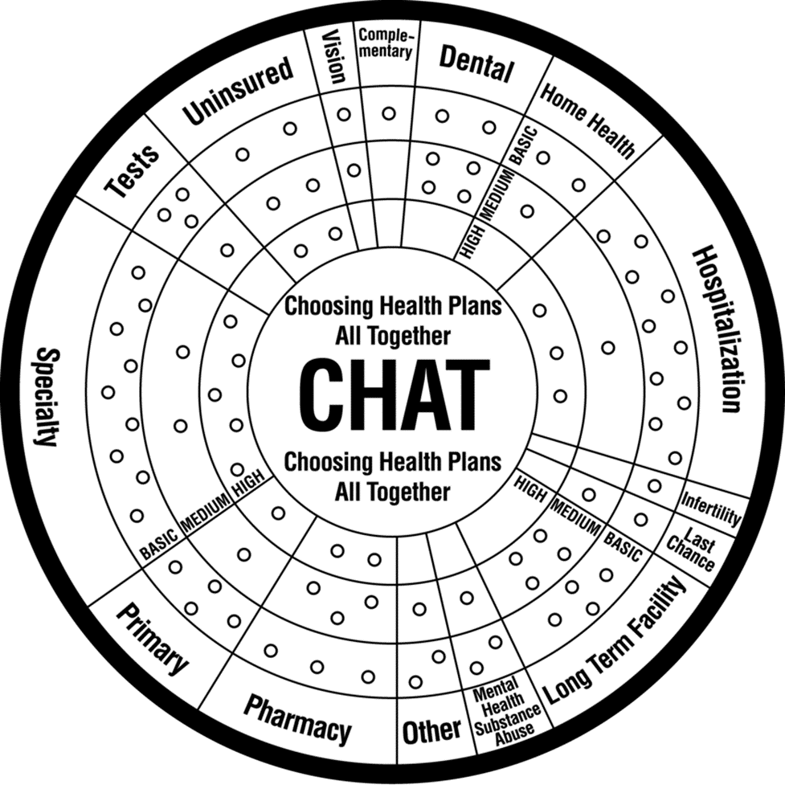
CHAT (Choosing Healthplans All Together) Exercise¹
Goal?
Communicate HBP clearly
Emphasize necessary trade-offs
CHAT ‘gamifies’ creating an HBP
Rationing of limited resources
Many different healthcare options
Different levels of intensity
CHAT is easy to understand and well liked
97% of participants found easy to do
86% of participants satisfied with their plan
CHAT already used for Swiss HBP ²
¹ Danis, Marion, Andrea K. Biddle, and Susan Dorr Goold. 2002. “Insurance benefit preferences of the low income
uninsured.” Journal of General Internal Medicine 17 (2): 125–33. https://doi.org/10.1046/j.1525-
1497.2002.10609.x.
² Hurst, Samia A., Mélinée Schindler, Susan D. Goold, and Marion Danis. 2018. “Swiss-CHAT: Citizens discuss
priorities for Swiss health insurance coverage.” International Journal of Health Policy and Management 7 (8): 746–54. https://doi.org/10.15171/ijhpm.2018.15.

Slide 18
Research Questions
Mediating Factors
Perceived Equity of UHC
Comprehensibility of UHC
Moderating Factors
Subjective Numeracy
Objective Numeracy

Slide 19
Research Questions
Does HBP ↑ UHC Support?
Mediating Factors ↑ UHC Support?
Moderating Factors ↑ UHC Support?
Best way to ↑ UHC support?

Slide 20
Hypothesis
HBP ↑ Perceived Equality / Comprehensibility
Mediational relationship
Perceived Equality ↑ UHC Support
Perceived Comprehensibility ↑ UHC Support
Moderating Factors – No a priori hypothesis

Slide 21
?
Perceived Equality
?
Condition
?
Support for UHC
?
?
Understanding

Slide 22
Study 1

Slide 23
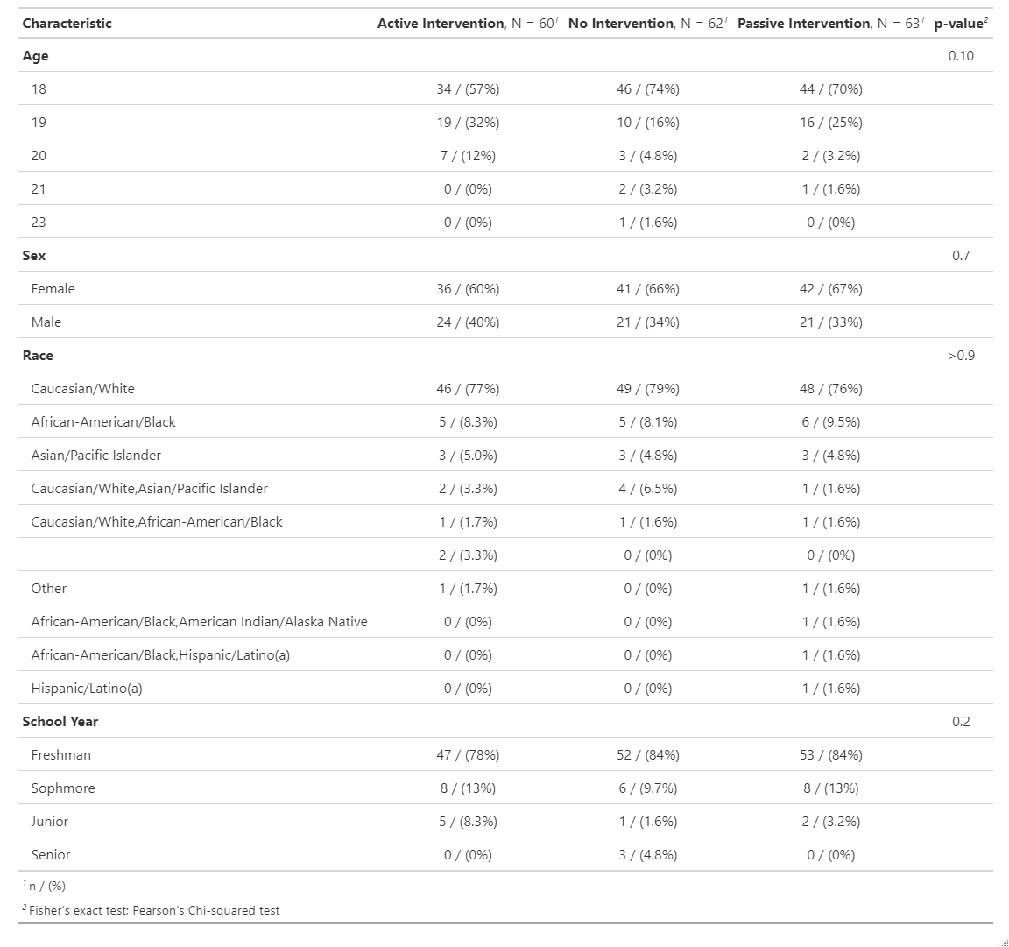

Slide 24
Method: Measures
Pre-Test
Support for Universal Health Care ¹
Post-Test
Pre-test measure
Free response: Thoughts on activity
Likelihood to want UHC plan
Pay for Insurance / Ever been uninsured (Y/N)
¹ Shen, Megan Johnson, and Jordan P. Labouff. 2016. “More than political ideology: Subtle racial prejudice as
a predictor of opposition to universal health care among U.S. Citizens.” Journal of Social and Political
Psychology 4 (2): 493–520. https://doi.org/10.5964/jspp.v4i2.245..

Slide 25
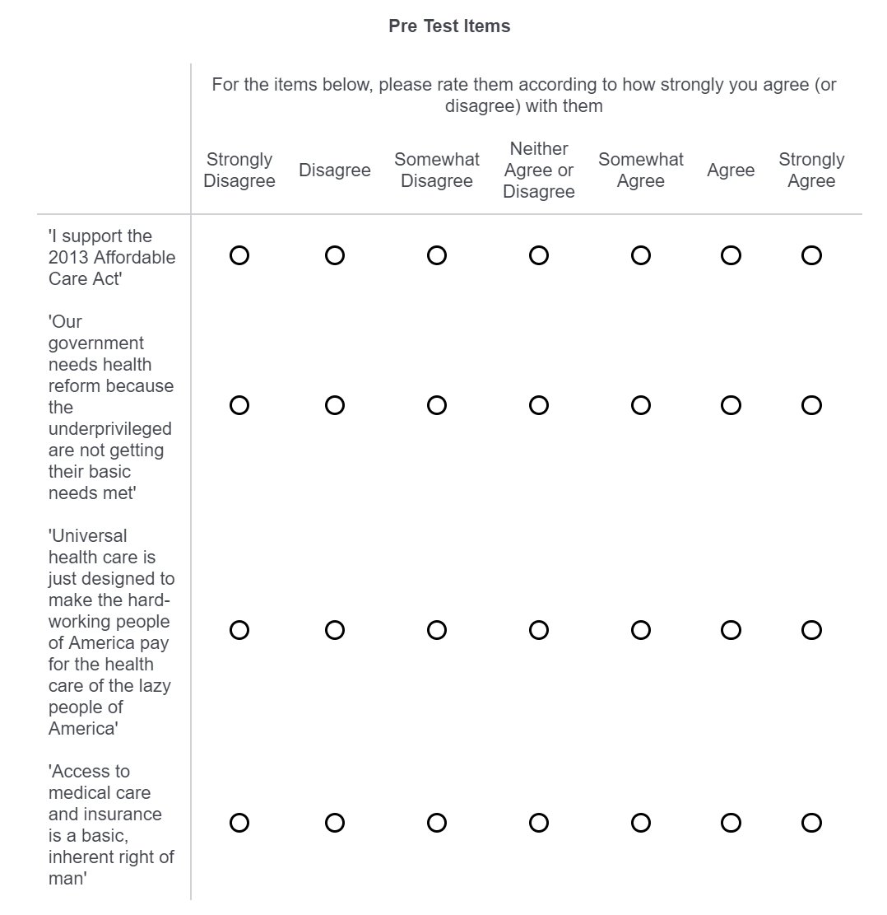

Slide 26
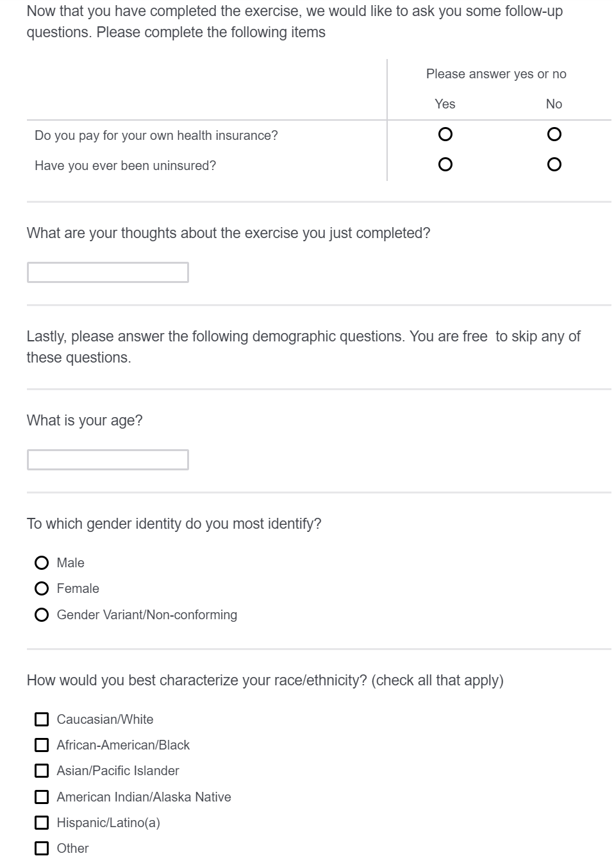

Slide 27
Method: Design
2x3 mixed subjects design
Multi level model
Measurement Time > Subject
Independent variable
Time of measurement (pre/post intervention)
Experimental condition (control/active/passive)

Slide 28
Method: Materials
Choosing Healthplans All Together (CHAT) Exercise ¹
“Blank” version – Active
“Filled” version – Passive
“Pizza” version - Control
¹ Danis, Marion, Andrea K. Biddle, and Susan Dorr Goold. 2002. “Insurance benefit preferences of the low income
uninsured.” Journal of General Internal Medicine 17 (2): 125–33. https://doi.org/10.1046/j.1525-
1497.2002.10609.x.

Slide 33
Method: Procedure
Cubicle with Qualtrics survey
Pre-test measures given
Randomization
Control
Intervention
Active
Passive
Post-test measures given
Debrief

Slide 34
Results – Study 1

Slide 35
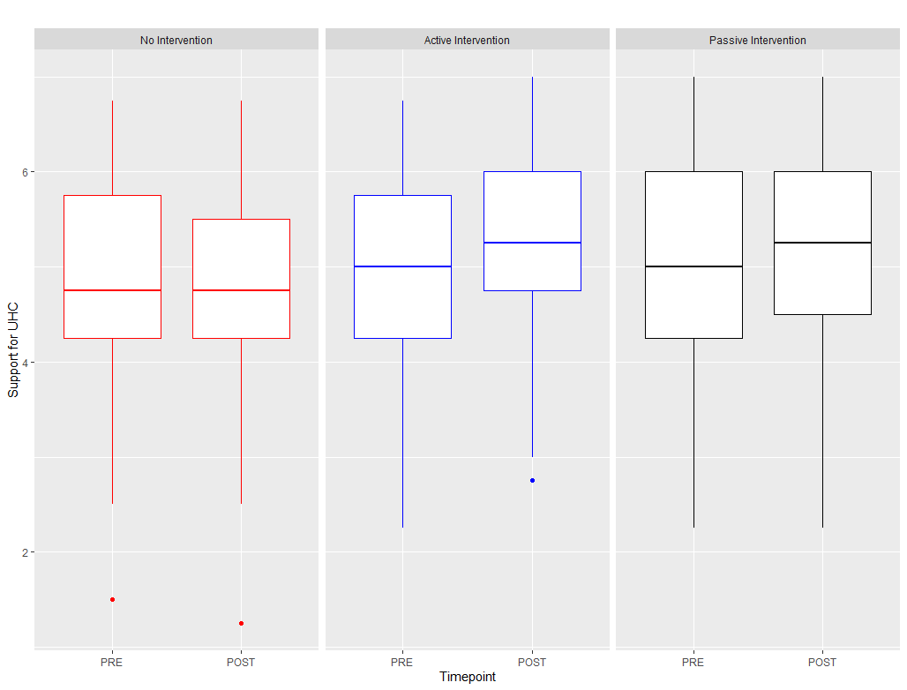

Slide 36
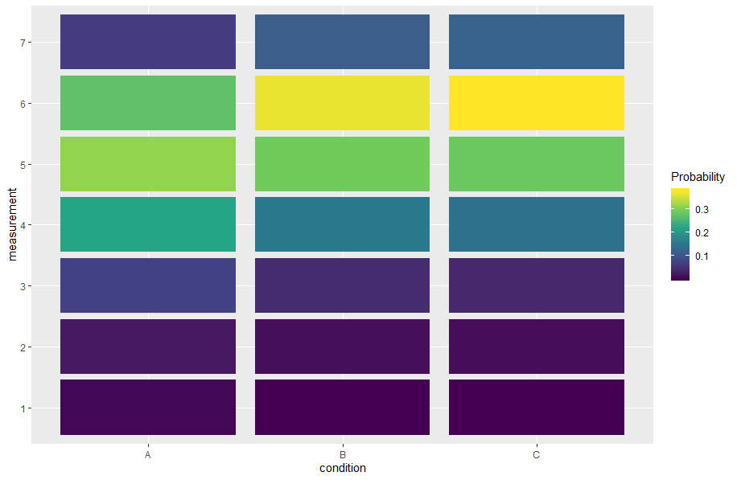
Control
Active
Passive

Slide 37
Results: Quantitative
Intervention:
↑ UHC Support!
Active = Passive
Time Spent:
No effect on UHC support

Slide 38
Results: Qualitative
“ What are your thoughts about the exercise you just completed?”
Confusion? – 10%
“It was a little confusing if you aren't very familiar with insurance and health care.”
Interesting! – 32%
“It was hard to choose because some of the parts in the insurance plan would've been nice to have but no necessary for me personally.”

Slide 39
What did we change?
Control and Intervention only
Control – “Standard” UHC messaging
Mediating Factors
Complexity
Perceived Equality/Fairness
Moderating Factors
Subjective Numeracy
Objective Numeracy
Javascript CHAT exercise
Sliders instead of Likert measures

Slide 40
Study 2

Slide 41
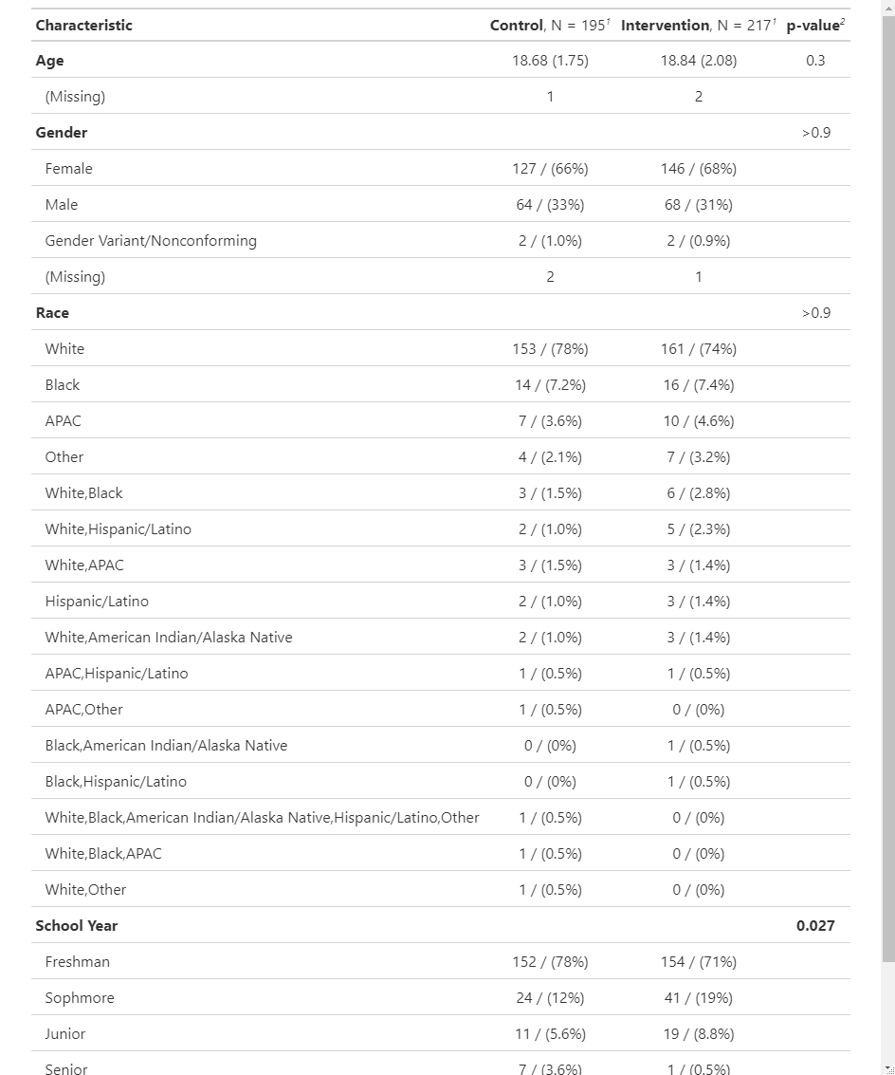

Slide 42
Method: Measures
Pre-Test
Support for Universal Health Care
Mediational Factors
Understanding of UHC ¹
Equity of UHC ²
Post-Test
Pre-test measures
Free response: Thoughts on activity
Likelihood to want UHC plan
Moderating Factors
Numeracy
Subjective Numeracy Scale ³
Rasch Numeracy Scale ⁴
Pay for Insurance / Ever been uninsured (Y/N)
¹Mulken, Margot van, Rob le Pair, and Charles Forceville. 2010. “The impact of perceived complexity,
deviation and comprehension on the appreciation of visual metaphor in advertising across three European
countries.” Journal of Pragmatics 42 (12): 3418–30. https://doi.org/10.1016/j.pragma.2010.04.030.
³ Fagerlin, Angela, Brian J. Zikmund-Fisher, Peter A. Ubel, Aleksandra Jankovic, Holly A. Derry, and Dylan
M. Smith. 2007. “Measuring numeracy without a math test: Development of the subjective numeracy
scale.” Medical Decision Making 27 (5): 672–80. https://doi.org/10.1177/0272989X07304449.
²Netemeyer, Richard G., James S. Boles, and Robert McMurrian. 1996. “Development and validation of
work-family conflict and family-work conflict scales.” Journal of Applied Psychology 81 (4): 400–410.
https://doi.org/10.1037/0021-9010.81.4.400.
⁴ Weller, Joshua A., Nathan F. Dieckmann, Martin Tusler, C. K. Mertz, William J. Burns, and Ellen Peters.
2013. “Development and Testing of an Abbreviated Numeracy Scale: A Rasch Analysis Approach.”
Journal of Behavioral Decision Making 26 (2): 198–212. https://doi.org/10.1002/bdm.1751.16

Slide 43
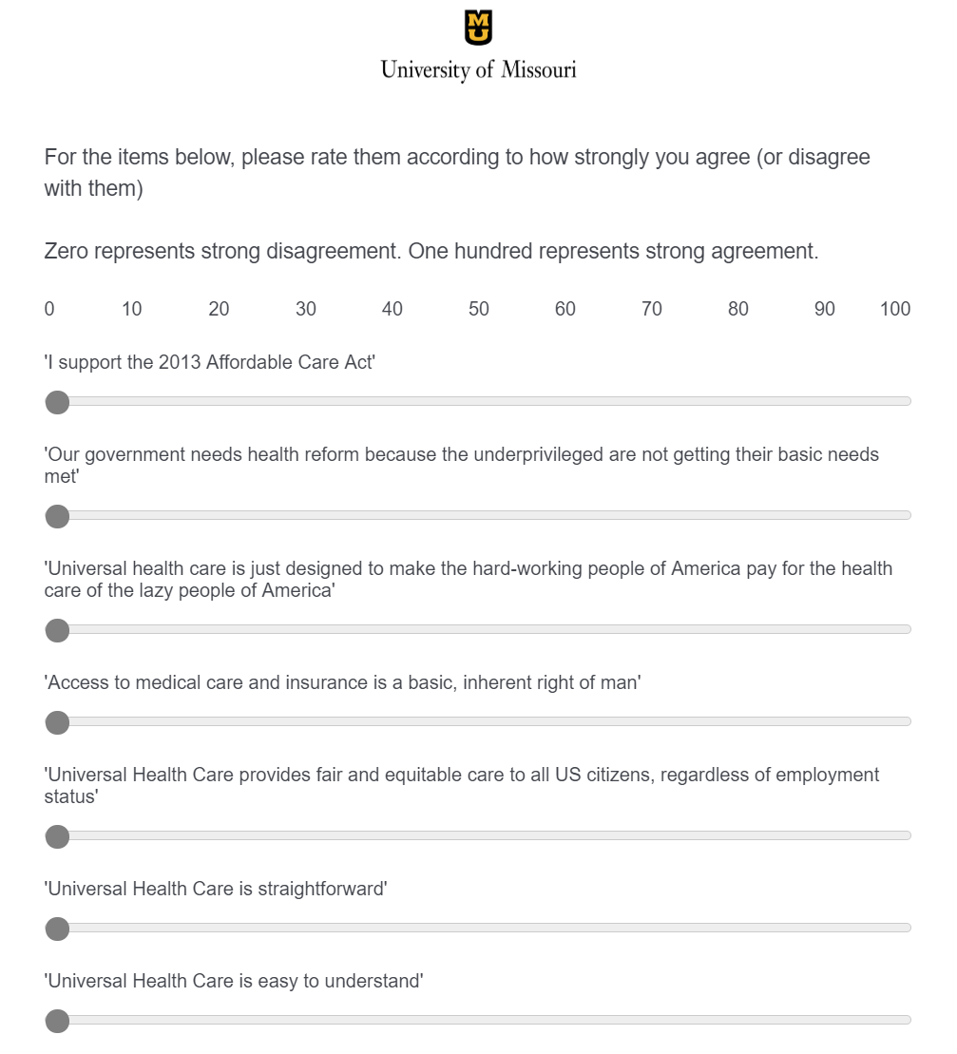

Slide 44
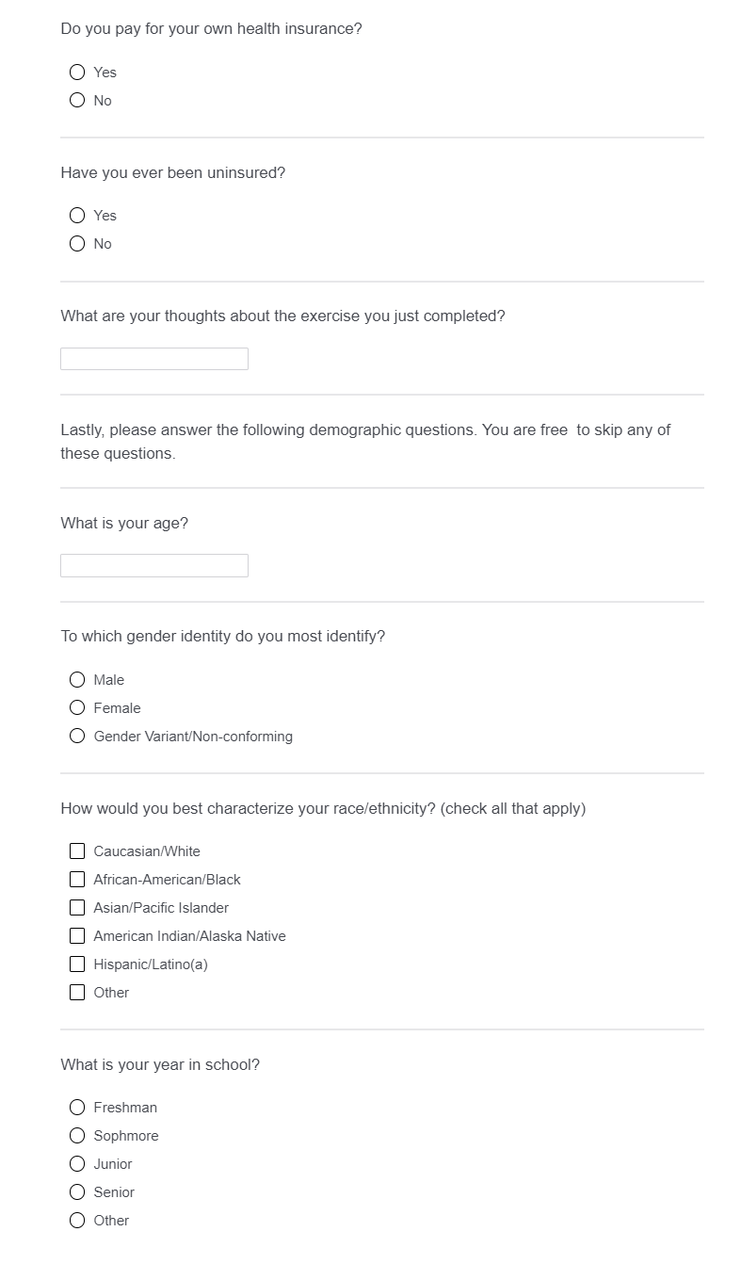

Slide 45
Method: Design
2x2 mixed subjects design
Multi level model
Measurement Time > Subject
Independent variable
Time of measurement (pre/post intervention)
Experimental condition (control/HBP exercise)

Slide 46
Method: Materials
Choosing Healthplans All Together (CHAT) exercise
Web-exercise version
‘Traditional’ UHC information
Pamphlets from WHO ¹ and World Bank ²
¹ https://www.who.int/health-topics/universal-health-coverage#tab=tab_1
² www.worldbank.org/health

Slide 48
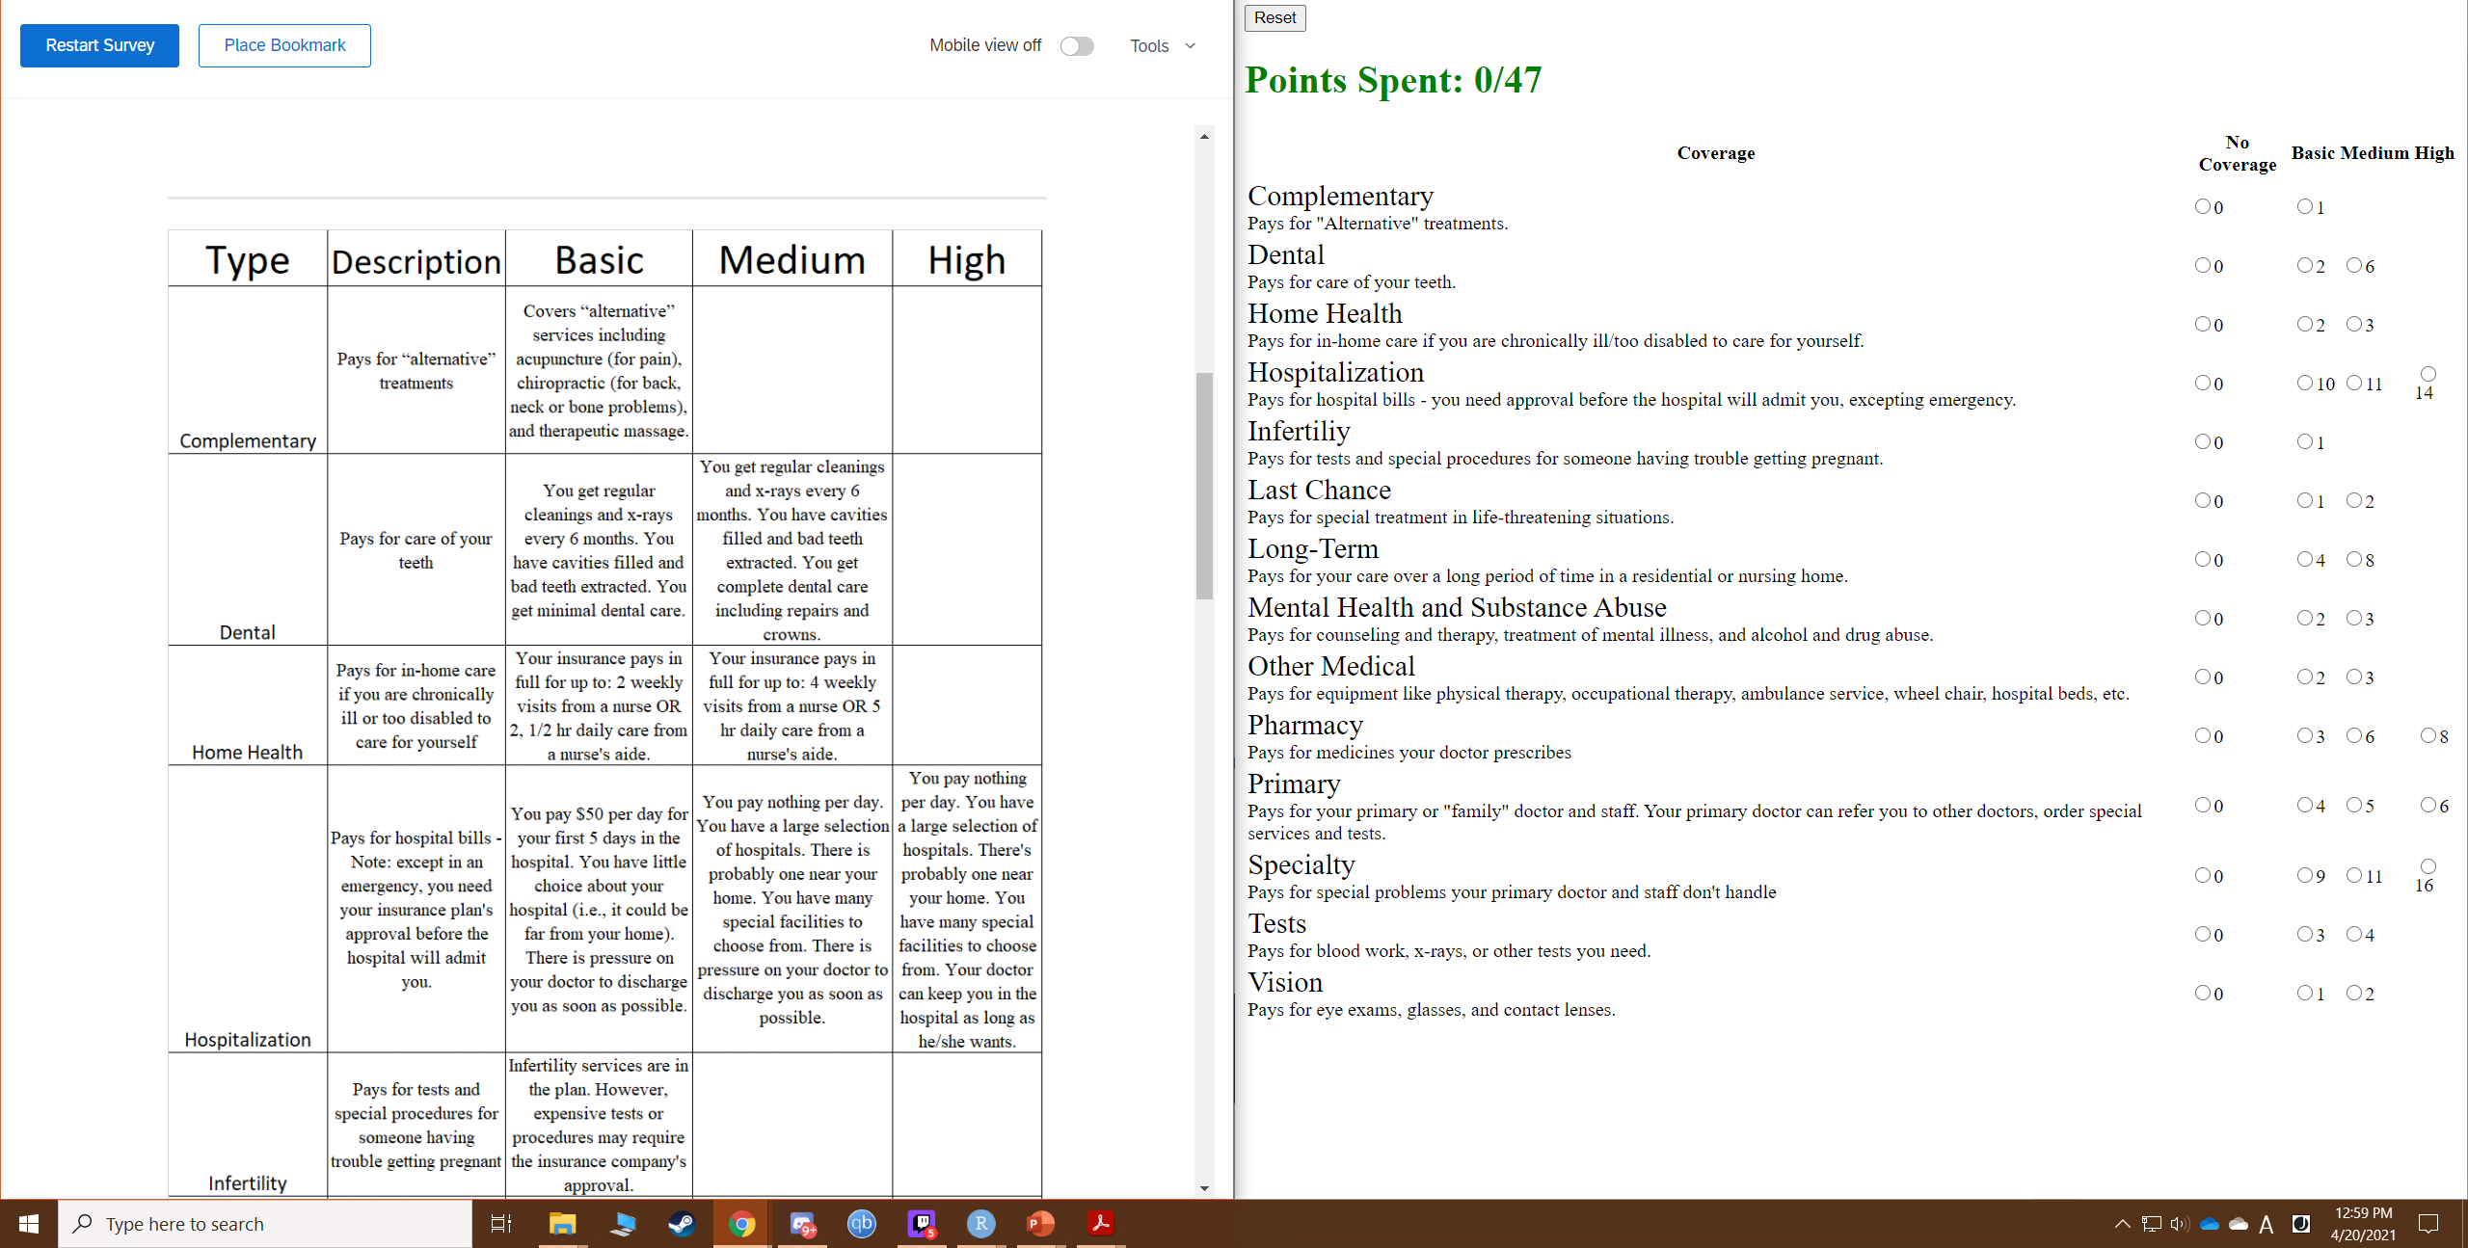

Slide 50
Method: Procedure
Online Link to Qualtrics survey
Pre-test measures given
Randomization
Control
3 UHC infographics
Intervention
HBP activity in separate screen
HBP ‘legend’ on survey screen
Post-test measures given
Debrief

Slide 51
Method: Modelling
Multi-level model
Time nested within Subject
Time x Condition ↑ Support UHC?
Linear Models
Numeracy x Intervention ↑ Support UHC?
Moderating Relationship
Perceived Equality affects Intervention ↑ Support UHC?
Mediational Relationship
Comprehensibility affects Intervention ↑ Support UHC?
Mediational Relationship

Slide 52
Results – Study 2

Slide 53
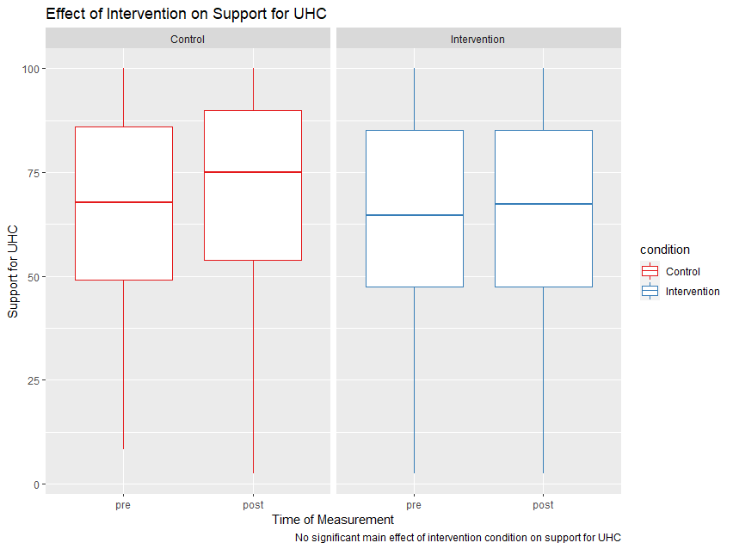

Slide 54
Results – Mediational Effects

Slide 56
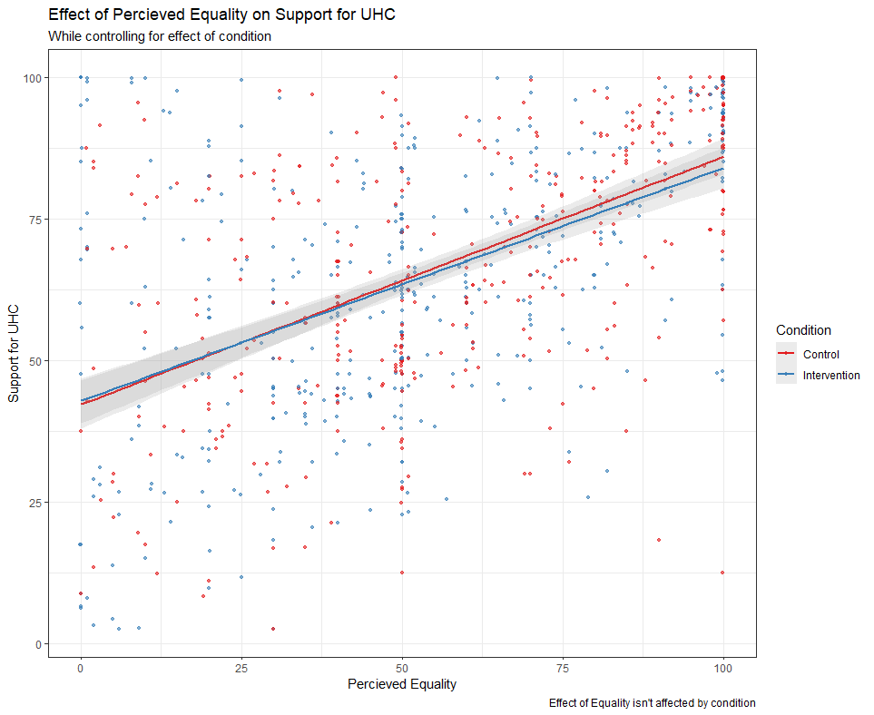

Slide 57
Perceived Equality
-4.53 **
0.42 ***
Condition
Support for UHC
-3.547 * (.04)

Slide 58
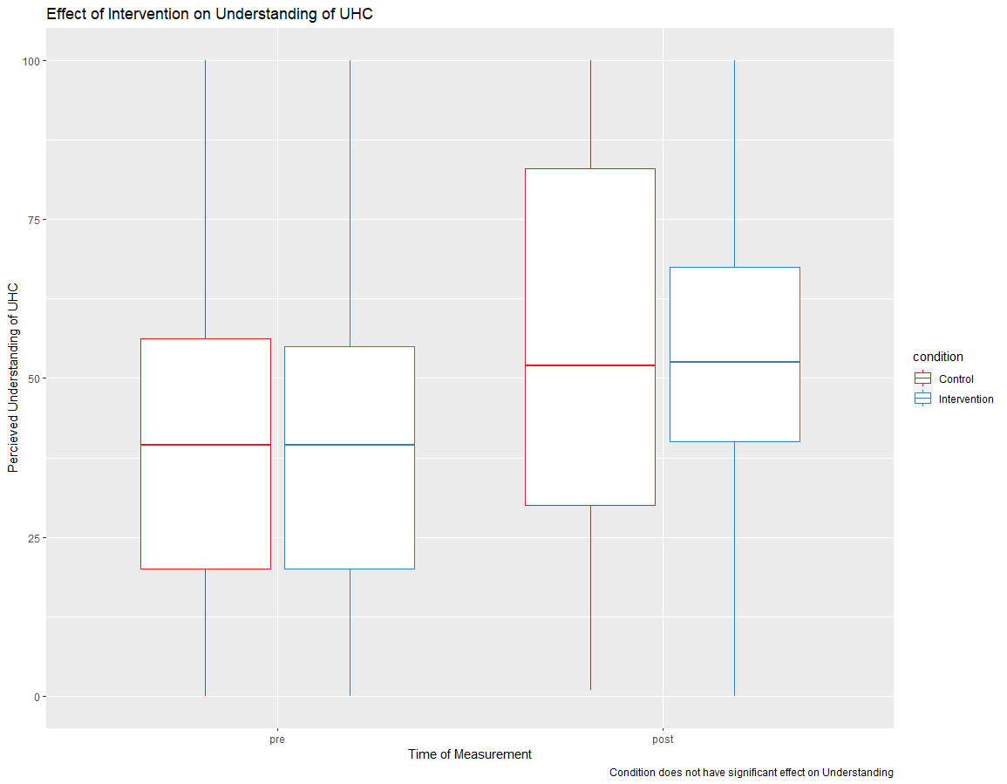

Slide 59
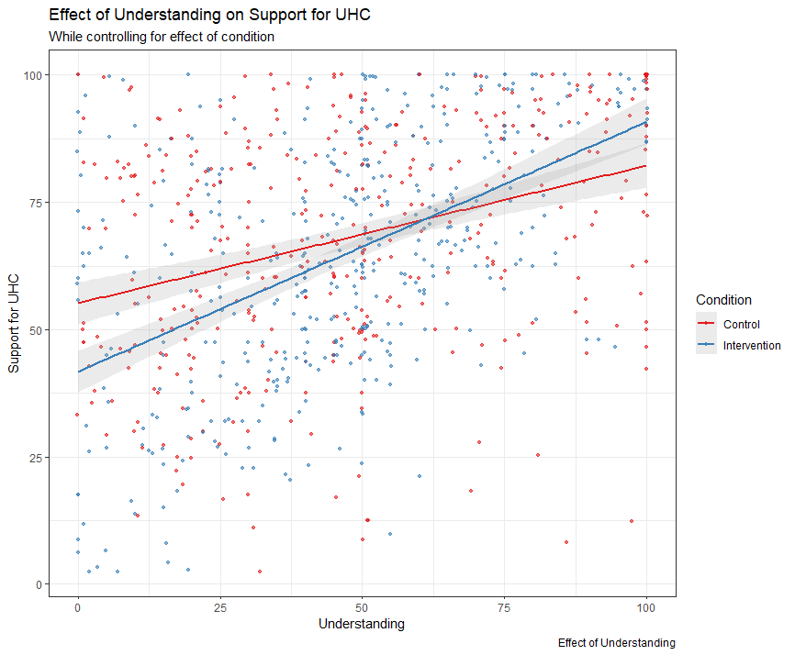

Slide 60
Results – Moderating Effects

Slide 61
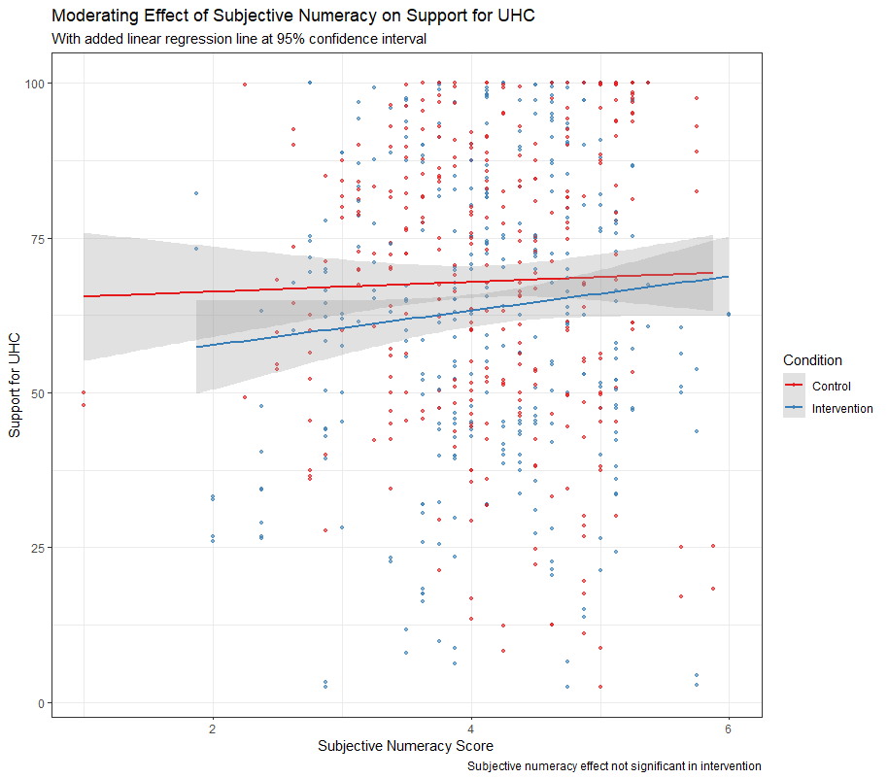

Slide 63
Results: Quantitative
Intervention did not ↑ Support UHC
Mediational Relationship exists!
Intervention did not ↑ Perceived Equality
Perceived Equality ↑ Support UHC
Control did ↑ Perceived Equality
No difference in ↑ Understanding b/w conditions
Understanding ↑ Support UHC
Moderating Relationship Exists!
Subj Numeracy does not ↑ Support UHC
Obj Numeracy ↑ Support UHC
Intervention only!

Slide 64
Results: Qualitative
Difficult
“it was much more difficult than I thought it was going to be; I had to compromise points in some places to be able to get at least basic coverage in other areas”
Interesting
“Interesting that my answers changed. I would be interested in seeing someone against Universal Health Care make a study, too.”
Enjoyable/Fun/Worked
“Enjoyed it, overall I believe that there should be Universal Health Care, but I did not realize how complicated it was. This exercise showed me how complicated it will be if the US decides to go through with something like this.”

Slide 65
Results: Qualitative
Intervention
Difficult – 23%
Interesting – 49.8%
Enjoyable/Fun/Worked – 18.4%
Control
Difficult – 0%
Interesting – 53%
Enjoyable/Fun/Worked – 8.7%

Slide 66
Extensions?
Using LIWC for more structured qualitative analysis
More ‘neutral’ control material?
Measure political orientation?
Compare against private healthcare info?
Determine how/why objective numeracy ↑ UHC supp in intervention only?
Can we measure actual equity vs perceived equity?

Slide 67
Conclusion
Mediational relationship of Perceived Equity exists!
Perceived Equity ↑ UHC Support
Control ↑ Perceived Equity
Intervention does not ↑ Perceived Equity
Mediational relationship of Comprehensibility does not exist.
Understanding ↑ UHC Support
Both conditions ↑ Understanding equally

Slide 68
Conclusion
Moderating Effect of numeracy exists!
Subjective Numeracy does not ↑ UHC Supp
No difference in either condition
Objective Numeracy ↑ UHC Supp
Interaction with the intervention
No effect in the control condition
Free response differences
Intervention: More fun to engage with!
Difficult choices perhaps effecting affect?
Control: No confusion or difficulty whatsoever
Both conditions were interesting!

Slide 69




My sincerest gratitude for those around me:
Victoria Shaffer, Jinwen Tang, Jenna Rogers, Katy Valentine, Pete Weiger
Finally: All of you for coming and listening to my presentation!

Slide 70
Questions?

